Slide 1

Bringing Pharmaceutical Care to the 21 Century
Notes:
Bringing Medical Care to the 21 Century
Bringing Pharmaceutical Care to the 21 Century
Modernizing Medical Care
Medical Care of Tomorrow
Take charge of your medications
Your Daily Medical/Medication Companion

Slide 2

The Problem
Problem
Regularly changing regimen
Hard to keep track and remember
Daily life is disturbed
https://www.epilepsyresearch.org.uk/poll-shows-that-almost-50-of-people-forget-to-take-their-medication-at-least-once-a-month/
Notes:
Add a statistic
Madeeha

Slide 3

The Solution
A smartphone medication tracking app that uses Machine Learning and latest technology to improve the quality of life for anyone taking medications
Notes:
Add tagline about product → mission statement
Cesar - response to problem

Slide 4



Solution
Adding Medications Made Simple!
Medication Tracking
Reminders
Ease of use
Notes:
Here’s how we solve this one problem → demo that
Cesar

Slide 5


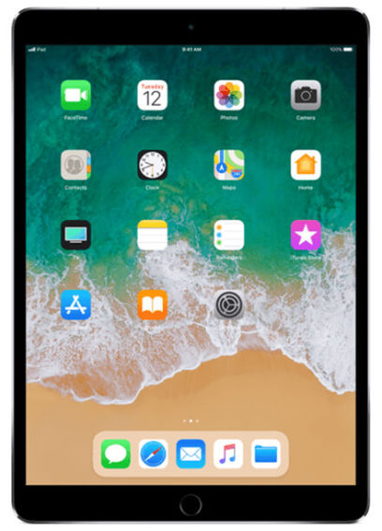

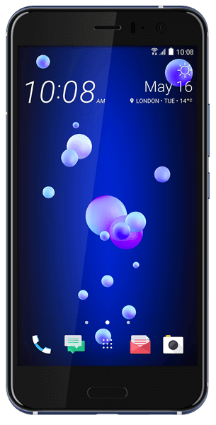

How it works
Step 1
Step 2
Step 3
Download app and sign up
Add Medications
Receive notifications and other benefits
Notes:
Diagram and walk through it
Carlos

Slide 6





Advantages
Planned & Designed with the future in mind
Machine
Learning
Accessibility
Features
The Cloud
Notes:
How the things we did in designing it make it better than the competition → demo those things
Carlos

Slide 7






Next steps
Machine Learning
Improved Communication
Caregivers
Freemium Model
Notes:
Talk about how to extend our product and the advantages of those extensions
Cesar
Continue to leverage ML technologies - speech recognition and text to speech for accessibility.
ML to understand user behaviour and medication pattern
Improved patient to pharmacist communication
Caregiver functionality - allowing a close family member or caregiver to monitor the patient's medication history.
Offline Mode
Freemium Model

Slide 8



Market
Elderly
People with disabilities
Working people
Notes:
Talk about other audiences and how they could benefit
Madeeha

Slide 9

Mission statement
Mission Statement
Pillbox aims to create a product that will be indispensable in navigating the healthcare system
Notes:
How this product can be integrated into your everyday life
Madeeha

Slide 10
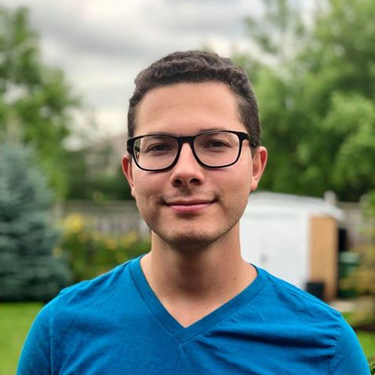




Who we are
Carlos Santana
Cesar Santana
Madeeha Khan
Software & Automation Developer at Bell CEO of CS Software Android App with 100K+ Downloads
santanjc@mcmaster.ca
Software Development Engineer at AMD
santanca@mcmaster.ca
Program Management
Software Development
Program Manager at Microsoft
khamn57@mcmaster.ca

Slide 11
Thank You

